Slide 1


Day 2: Text Elements, Media Embedding, and Graphics
Presenter: AI Development Team

Slide 2


Content
1. Understanding Text-Level Semantics
2. Embedding Multimedia in HTML5
3. Utilizing the Canvas Element for Graphics
4. Exploring SVG for Scalable Graphics
5. Summary and Best Practices

Slide 3


Section 1
Understanding Text-Level Semantics

Slide 4



Introduction to HTML5 Inline Elements
01
02
03
Definition of Inline Elements
New HTML5 Inline Elements
Usage and Examples
Understanding how to implement these inline elements is crucial; for instance, using <mark> to highlight important text or <time> to denote specific dates enhances the semantic structure of the webpage, making it more informative for both users and search engines.
Inline elements in HTML5 are used to format small sections of content within block elements, allowing for text-level semantics and enhancing the meaning of the text without disrupting the flow of the document.
HTML5 introduced several new inline elements such as <mark>, <time>, <progress>, and <meter>, each serving specific purposes to improve accessibility and user experience by providing additional context to the content.

Slide 5

The <mark> Element: Highlighting Text
Purpose of the <mark> Element
The <mark> element is used to highlight text that is of particular relevance or importance within a document, making it visually distinct and easily identifiable for readers.
Semantic Significance
By using the <mark> element, developers enhance the semantic meaning of the content, which can improve accessibility for screen readers and assistive technologies, allowing users to better understand the context of highlighted information.
Styling and Customization
The default styling of the <mark> element typically includes a yellow background, but it can be customized using CSS to fit the design of the webpage, providing flexibility in how highlighted text is presented visually.

Slide 6




The <time> Element: Representing Dates and Times
Purpose of the <time> Element
Attributes for Enhanced Functionality
Browser Support and Accessibility
The <time> element is specifically designed to represent a specific time or date, allowing developers to mark up temporal information in a way that is both machine-readable and human-readable, enhancing the semantic structure of the document.
The <time> element can utilize the datetime attribute to provide a machine-readable format of the date or time, which is crucial for search engines and applications that parse web content for scheduling, events, or time-sensitive information.
Most modern browsers support the <time> element, and its proper use can improve accessibility by allowing screen readers to convey time-related information more effectively, ensuring that all users can understand the context of the dates and times presented.

Slide 7
The <progress> and <meter> Elements: Visualizing Data
01
02
03
Purpose of the <progress> Element
Functionality of the <meter> Element
Accessibility Considerations
The <progress> element is used to represent the completion status of a task, providing a visual indication of progress in a user-friendly manner, which is particularly useful in scenarios like file uploads or download statuses.
The <meter> element displays a scalar measurement within a known range, such as disk usage or battery level, allowing users to quickly assess the current value relative to the minimum and maximum limits defined by the attributes.
Both <progress> and <meter> elements enhance accessibility by providing semantic meaning to visual data, which can be interpreted by assistive technologies, ensuring that all users, including those with disabilities, can understand the information being conveyed.

Slide 8
Section 2
Embedding Multimedia in HTML5

Slide 9



Overview of Multimedia Embedding
Native Multimedia Support
Key Multimedia Elements
Accessibility and Fallbacks
HTML5 provides native support for multimedia embedding, allowing developers to integrate audio and video content directly into web pages without relying on third-party plugins, enhancing compatibility and user experience across different devices and browsers.
The primary elements for embedding multimedia in HTML5 include <video> for video content and <audio> for sound files, each equipped with attributes like controls, autoplay, and loop to customize playback options and improve user interaction.
Ensuring accessibility is crucial when embedding multimedia; developers should provide fallback content or alternative text for users with disabilities, as well as consider browser compatibility to ensure that all users can access the intended media regardless of their technology.

Slide 10

The <video> Element: Integrating Video Content
Embedding Video in HTML5
The <video> element allows for seamless integration of video content directly into web pages, providing a standardized way to display videos across different browsers without the need for external plugins.
Essential Attributes for Control
Key attributes such as controls, autoplay, muted, and loop enhance user experience by allowing users to control playback, while the poster attribute provides a preview image before the video starts, improving engagement.
Browser Compatibility and Formats
To ensure broad compatibility, it is important to provide multiple video formats (e.g., MP4, WebM, Ogg) within the <source> tags, as different browsers may support different formats, ensuring that all users can access the video content.

Slide 11
The <audio> Element: Adding Sound Files
01
02
03
Purpose of the <audio> Element
Key Attributes for Customization
Browser Support and Formats
The <audio> element is designed to embed sound files directly into web pages, allowing for seamless audio playback without the need for external plugins, enhancing user engagement and interactivity.
Important attributes such as controls, autoplay, and loop provide users with playback options, enabling them to play, pause, and repeat audio tracks easily, thus improving the overall user experience.
To ensure compatibility across different browsers, it is essential to include multiple audio formats (e.g., MP3, Ogg, WAV) within the <source> tags, as this allows the audio to be played on various devices and platforms without issues.

Slide 12

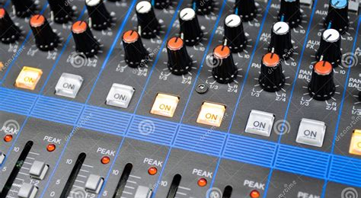

Attributes for Multimedia Elements
Video Element Attributes
Audio Element Attributes
Accessibility Considerations
The <video> element includes attributes such as controls, which provides a user interface for playback, autoplay to start the video automatically, muted to play without sound, loop to repeat the video, and poster to display an image before the video plays, enhancing user experience and engagement.
The <audio> element features attributes like controls for playback options, autoplay to begin playback immediately, and loop to repeat the audio track, allowing developers to customize audio playback and improve accessibility for users with different needs.
When using multimedia attributes, it is essential to ensure that all elements are accessible; providing alternative text for audio and video content, as well as ensuring that controls are keyboard-navigable, helps create an inclusive experience for users with disabilities.

Slide 13
Section 3
Utilizing the Canvas Element for Graphics

Slide 14
Introduction to the <canvas> Element
01
02
03
Definition and Purpose
JavaScript Dependency
Use Cases and Applications
The <canvas> element is a versatile HTML5 feature that allows for dynamic, scriptable rendering of 2D shapes, images, and text, making it essential for creating graphics and animations directly within web pages.
Unlike static image formats, the <canvas> element requires JavaScript for drawing and manipulating graphics, enabling developers to create interactive visual content that can respond to user inputs and events in real-time.
Common applications of the <canvas> element include game development, data visualization, and image editing tools, showcasing its flexibility and power in enhancing user engagement through rich graphical interfaces.

Slide 15

Drawing Shapes and Text with JavaScript
Canvas Context Setup
To draw shapes and text on the <canvas>, first obtain the drawing context using getContext('2d'), which provides methods for rendering 2D graphics, including shapes, lines, and text.
Drawing Basic Shapes
Utilize methods like fillRect(), strokeRect(), and beginPath() to create rectangles, circles, and other shapes, allowing for customization of colors, borders, and fill styles to enhance visual appeal.
Rendering Text on Canvas
Use the fillText() and strokeText() methods to display text on the canvas, with options to set font size, style, and alignment, enabling the integration of informative labels and annotations within graphical content.

Slide 16
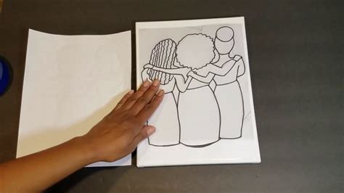

Practical Example: Creating a Simple Graphic
Setting Up the Canvas
Accessing the Drawing Context
Drawing a Simple Rectangle
Begin by defining the <canvas> element in your HTML with specific width and height attributes, ensuring it has a unique ID for easy access via JavaScript, which will allow you to draw graphics dynamically.
Use JavaScript to obtain the 2D drawing context of the canvas with getContext('2d'), which provides the necessary methods to draw shapes, lines, and text, enabling the creation of complex graphics.
Implement basic drawing commands such as fillStyle to set the color and fillRect(x, y, width, height) to create a filled rectangle, demonstrating how to visually represent data or create simple graphics on the canvas.

Slide 17
Limitations and Use Cases of Canvas
01
02
03
Performance Constraints
Lack of Accessibility Features
Use Cases in Gaming and Data Visualization
The <canvas> element can be resource-intensive, especially for complex graphics or animations, leading to performance issues on lower-end devices. Developers must optimize rendering techniques and consider frame rates to ensure smooth user experiences.
Unlike SVG, the <canvas> element does not inherently support accessibility features, making it challenging for screen readers to interpret content. Developers need to implement additional measures, such as providing alternative text or descriptions, to enhance accessibility.
The <canvas> element is particularly well-suited for applications like game development and real-time data visualization, where dynamic rendering and user interaction are essential. Its flexibility allows for the creation of rich graphical interfaces that can respond to user inputs effectively.

Slide 18
Section 4
Exploring SVG for Scalable Graphics

Slide 19
What is SVG? An Overview
Definition of SVG
SVG (Scalable Vector Graphics) is an XML-based vector image format that allows for the creation of two-dimensional graphics with support for interactivity and animation, making it ideal for web applications and responsive design.
Resolution Independence
Unlike raster images, SVG graphics are resolution-independent, meaning they can be scaled to any size without loss of quality, which is crucial for responsive web design and high-resolution displays.
Integration with HTML and CSS
SVG can be directly embedded within HTML documents, allowing for seamless integration with CSS for styling and JavaScript for interactivity, enhancing the overall user experience on web pages.

Slide 20
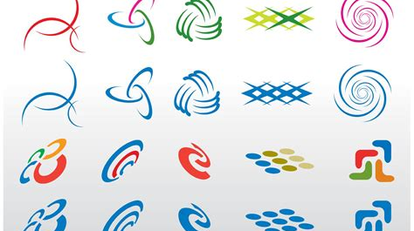
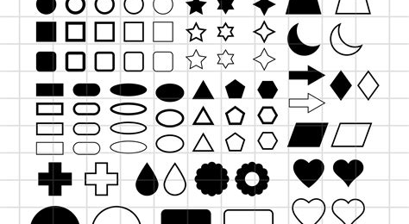
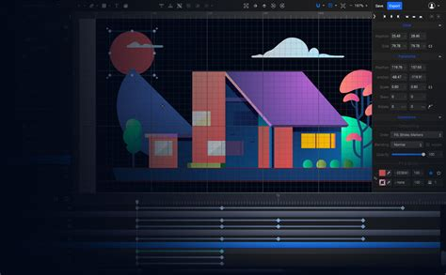
Creating Vector Graphics with SVG
Understanding SVG Basics
Key SVG Elements
Styling and Animation
SVG (Scalable Vector Graphics) is an XML-based format that allows for the creation of vector graphics, which are defined by mathematical expressions rather than pixels, enabling scalability without loss of quality.
Common SVG elements include <circle>, <rect>, <line>, and <path>, each serving specific purposes for drawing shapes, lines, and complex figures, allowing for detailed and customizable graphics directly in HTML.
SVG graphics can be styled using CSS and animated with JavaScript, providing developers with powerful tools to create interactive and visually appealing graphics that enhance user engagement on web pages.

Slide 21
Practical Example: Drawing a Circle
01
02
03
SVG Circle Basics
Styling the Circle
Responsive Design Considerations
To draw a circle using SVG, the <circle> element is utilized, which requires attributes such as cx (center x-coordinate), cy (center y-coordinate), and r (radius) to define the circle's position and size within the SVG canvas.
The appearance of the circle can be customized using attributes like stroke for the outline color, stroke-width for the thickness of the outline, and fill for the interior color, allowing for visually distinct graphics that can enhance user interfaces.
SVG circles are resolution-independent, making them ideal for responsive web design; they can scale to different screen sizes without losing quality, ensuring that graphics remain sharp and clear across various devices and resolutions.

Slide 22
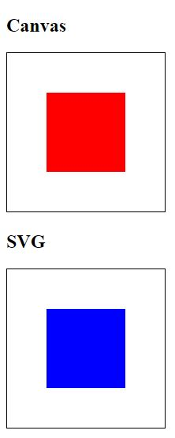
Advantages of Using SVG Over Canvas
Resolution Independence
SVG graphics are vector-based, allowing them to scale infinitely without losing quality, making them ideal for responsive web design and high-resolution displays, unlike Canvas which can become pixelated when resized.
Accessibility Features
SVG supports accessibility features such as titles and descriptions, enabling screen readers to interpret the graphics, which enhances usability for visually impaired users, whereas Canvas lacks inherent accessibility support.
Ease of Manipulation
SVG elements can be easily manipulated with CSS and JavaScript, allowing for dynamic styling and animations directly within the markup, providing greater flexibility compared to Canvas, which requires more complex JavaScript for similar effects.

Slide 23
Section 5
Summary and Best Practices

Slide 24



Recap of Key Concepts
Text-Level Semantics in HTML5
Multimedia Embedding Features
Graphics with Canvas and SVG
HTML5 introduces new inline elements like <mark>, <time>, <progress>, and <meter>, enhancing the semantic structure of web content by providing specific meanings and improving accessibility for users and search engines.
The <video> and <audio> elements allow for seamless integration of multimedia content directly into web pages, offering attributes for customization and ensuring compatibility across different browsers without the need for external plugins.
The <canvas> element enables dynamic rendering of graphics using JavaScript, while SVG provides resolution-independent vector graphics, each serving unique use cases in web design, such as animations, data visualization, and responsive graphics.

Slide 25
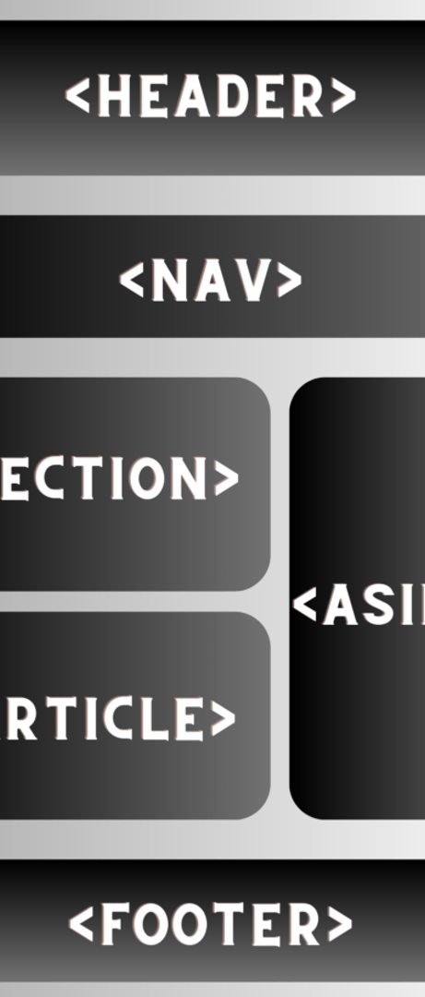
Best Practices for Using Text Elements
Utilize Semantic HTML
Always use the appropriate HTML5 text elements like <mark>, <time>, <progress>, and <meter> to enhance the semantic meaning of your content, improving accessibility and search engine optimization by providing context to the text.
Maintain Readability and Accessibility
Ensure that text elements are styled for readability, using sufficient contrast and font sizes, and consider accessibility features such as ARIA roles to assist users with disabilities in understanding the content.
Consistent Use of Inline Elements
Apply inline elements consistently throughout your document to maintain a coherent structure; this helps users and search engines navigate the content more effectively, enhancing the overall user experience.

Slide 26
Best Practices for Embedding Multimedia
01
02
03
Choose Appropriate Formats
Implement Accessibility Features
Optimize Loading Performance
Select video and audio formats that are widely supported across different browsers, such as MP4 for video and MP3 for audio, to ensure maximum compatibility and a seamless user experience.
Use techniques such as lazy loading for multimedia elements to improve page load times and overall performance, ensuring that media content does not hinder the user experience on your website.
Always include captions, transcripts, and alternative text for multimedia elements to enhance accessibility for users with disabilities, ensuring that all users can engage with the content effectively.

Slide 27
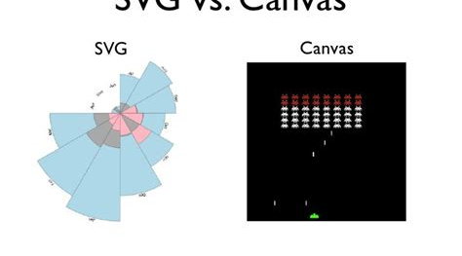
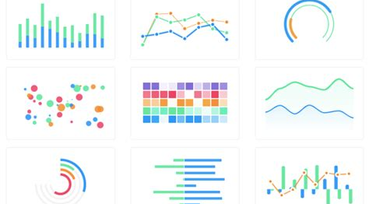

Choosing Between Canvas and SVG for Graphics
Performance Considerations
Interactivity and Accessibility
Use Case Suitability
When deciding between the two, consider the use case: Canvas is ideal for real-time graphics like games and data visualizations, while SVG is better suited for static graphics, icons, and illustrations that need to scale without losing quality.
The choice between Canvas and SVG often hinges on performance; Canvas is generally more efficient for rendering a large number of objects or complex animations, while SVG excels in scenarios requiring high-quality graphics and scalability.
SVG provides built-in support for interactivity and accessibility features, allowing developers to easily manipulate elements with CSS and JavaScript, whereas Canvas requires more complex coding to achieve similar interactivity and lacks inherent accessibility support.

Slide 28
Thank You
Contact: ai.team@example.com

